Slide 1
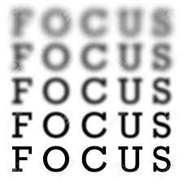
Contrast Based Autofocus
Cristóvão Diniz Trevisan

Slide 2
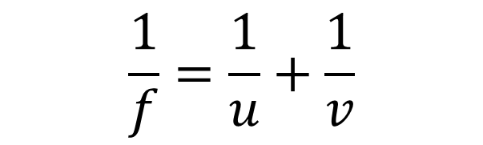
Focal length
The distance to focus depends on the distance between the object and camera (u)
$$\frac{1}{f}=\frac{1}{u}+\frac{1}{v}$$

Slide 3
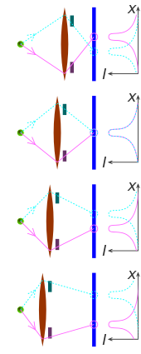
Types of Autofocus
Active AF:
Sensor to measure distance (laser, infrared, ultrasonic)
Passive AF:
Phase Detection (needs hardware - extra sensor):
Contrast Detection (only computational!)
Hybrid AF:
Complex, using both passive and active AF, may also detect objects (eg. face detection)

Slide 4
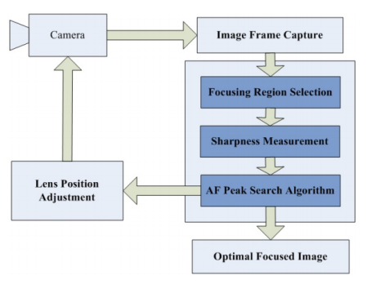
Contrast Based Autofocus
5 tries:
Standard deviation of intensity
Standard deviation of intensity with noise reduction
Standard deviation of histogram
Standard deviation along axes
Contrast Measure based on Squared Laplacian (CMLS)

Slide 5

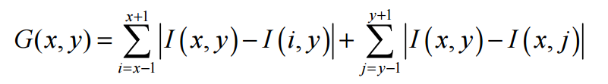
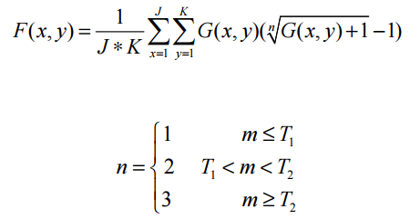

CMLS
Square Laplacian
Considering noise
$∆f= \frac{{\text{∂}}^{2}f}{\text{∂}x^{2}}$+ $\frac{{\text{∂}}^{2}f}{\text{∂}y^{2}}$

Slide 6
References
Xin Xu, Yinglin Wang, Jinshan Tang, Xiaolong Zhang and Xiaoming Liu. Robust Automatic Focus Algorithm for Low Contrast Images Using a New Contrast Measure. http://www.mdpi.com/1424-8220/11/9/8281/pdf [access 12/09/2015]
Laplace Operator. https://en.wikipedia.org/wiki/Laplace_operator [access 12/09/2015]
Autofocus. https://en.wikipedia.org/wiki/Autofocus [access 12/09/2015]
A lot of discussion forums …

